Slide 1
Entomopathogenic Fungi

Slide 2
Introduction
Over the past decade the agricultural map of world has changed vigorously.
Herewith, the use of pesticides is also increasing. Use of pesticide has increased 50 folds since 1950 leading to environmental problems like soil and ground water contamination with the pesticide residues
Random uses of insecticides cause the insects to acquire resistance against the insecticides

Slide 3
Introduction
Insect pest menace is a major factor that destabilizes crop productivity in agricultural ecosystems.
Development of chemical pesticides – usage by farmers
Disadvantages of chemical pesticides – development of resistance in pests, environmental persistence and toxicity.
Association of fungi with insects is well known and some of these cause serious diseases in hosts.
Safe towards humans, environment and non-target organisms.
These can be used in conjunction with synthetic chemical insecticides.
Most common entomopathogenic fungi are Beauveria bassiana, Metarhizium anisopliae, Nomuraea rileyi, Paecilomyces sps. Verticillium lecanii, Hirsutella thompsonii

Slide 4
Why Biocontrol
Environmentally compatible, naturally occurring
Broad or narrow targets depending on organism
Less prone to resistance
Low cost of development
Integrated control possible, reducing chemical use
Less expensive and Rapid registration

Slide 5
POTENTIAL AND STATUS OF EPF
Contact mode of action.
EPF have a broad host range and also cause epizootics.
Resistance in pests - Single site of action of Bt toxins Vs multiple site/multiple step mechanism of action.
EPF are ubiquitous to many environments – leads to the discovery of native-indigenous isolates.
Interaction of the EPF – host depends on the occurrence of non-specific and specific events between the conidia and the insect cuticle.
EPF can be easily grown on simple media and can be easily formulated.
Toxins and enzymes produced can be exploited

Slide 6
Biological pesticides
“Any molecules from the biological origin, whole organism or product derived from them” (Villaverde et al., 2014)
Bacillus thuringiensis (Bt)
Cry, Cyt, Vip
Bacteria
Needs to be ingested to act
Virus
Baculovirus
Beauveria, Metarhizium,
Lecanicillium lecanii
Isaria fumosorosea,
Acts by direct penetration (or)
Contact infection
Fungi

Slide 7
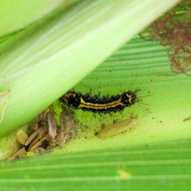
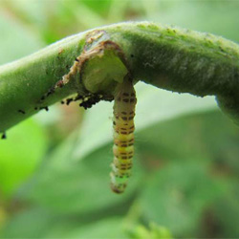
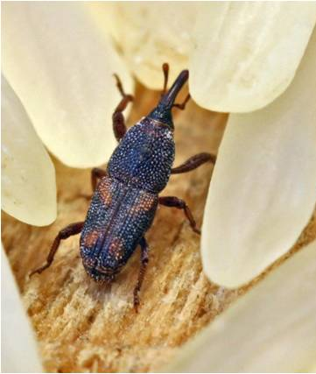
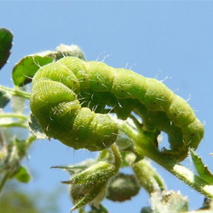
Entomopathogenic fungi
Metarhizium and Beauveria, approved by USEPA (Wang and Leger, 2013)
B. bassiana- Agostino Bassi, white muscardine fungi disease in silkworm
Metarhizum – may not be from insect origin, soil root interphase (St. Leger et al., 2011)- Green muscardine fungi
Coleoptera (Williams et al., 2013), Diptera (Kim et al., 2014), Lepidoptera (Ramzi and Zibaee., 2014), Hemiptera (Lacey et al., 2011), Thysanoptera (Wu et al., 2013)
http://agritech.tnau.ac.in/crop_protection/crop_prot_crop_sto_insect.html

Slide 8
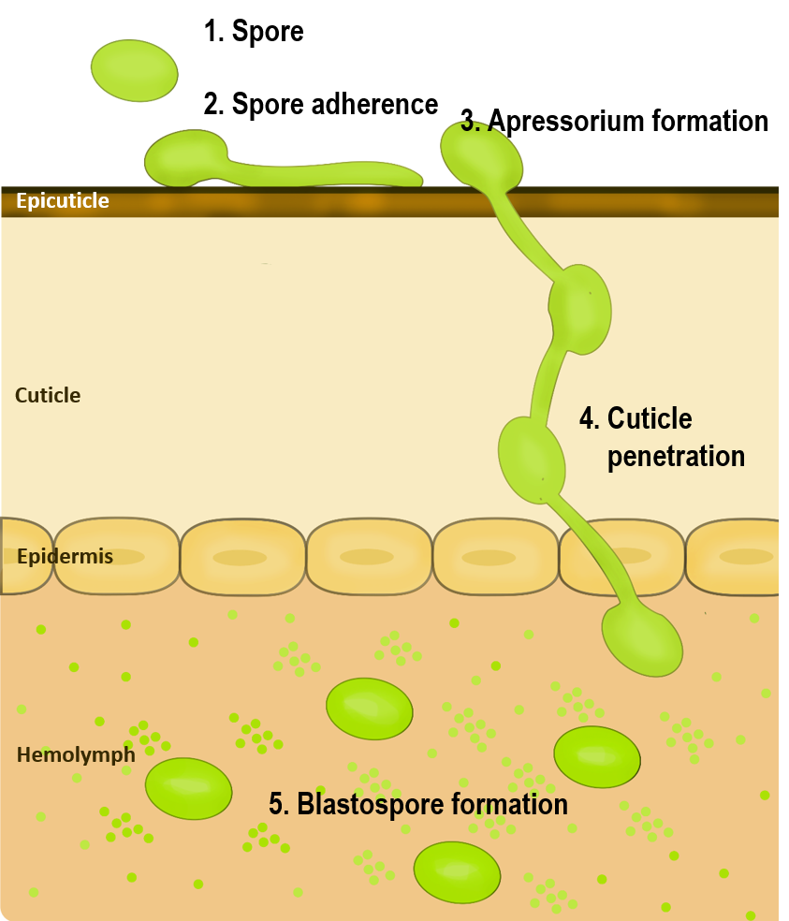
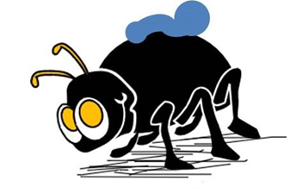
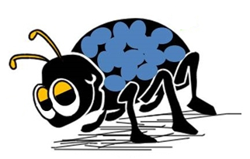
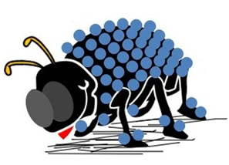
Entomopathogenic Fungi Life Cycle
2. Spore adherence
Hydrophobins and adhesins (Zhang et al., 2011)
3. Appressorium formation and Epicuticule penetration
MAPK (Zhang et al., 2010)
Cytochrome P450 (CYP52X1)
4. Cuticle penetration
Chitinases (CHIT1), proteases (PR1 and PR2)
5. Blastospores formation- Hemolymph

Slide 9
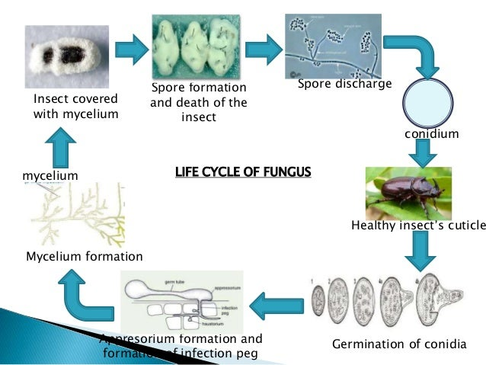
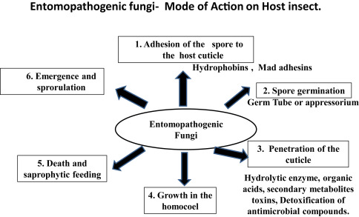

Slide 10
Entomopathogenic Fungi - Drawbacks
Low efficacy in killing the host
Sensitivity towards abiotic stress
Major crop loss even after infection
?
Reduction in Lethal spore dosage
Reduction in Lethal time

Slide 11
Major areas
Mass production, formulation and application.
Studies on toxins produced by entomopathogenic fungi
Strain improvement by following methods like
Transformation
Over expressing the extracellular enzymes
Engineering entomopathogenic fungi to express neuro toxin genes in order to enhance the virulence.
In vitro anticancer effects (Breast cancer)

Slide 12
Mass production
A considerable effort has been made to establish entomopathogenic fungi as a commercial mycopesticide by using Solid State Fermentation (SSF) as a suitable method for mass production
Conidia produced by SSF are considered to be similar to those produced on insect cadavers
A comparative study shows production of 10¹³ conidia, costs the same as chemical insecticides used per hectare. This high production efficiency leads to the development of consciousness to mass produce conidia of entomopathogenic fungi in a cost effective way
It is preferred in order to produce many industrially important enzymes and antibiotics due to high productivity, low cost and easier downstream processing
The maintenance of conidial viability in formulations during storage is crucial for obtaining effective insect control in the field
Compatibility between production, formulation and application techniques is vital for the successful use of microbial biopesticides.

Slide 13
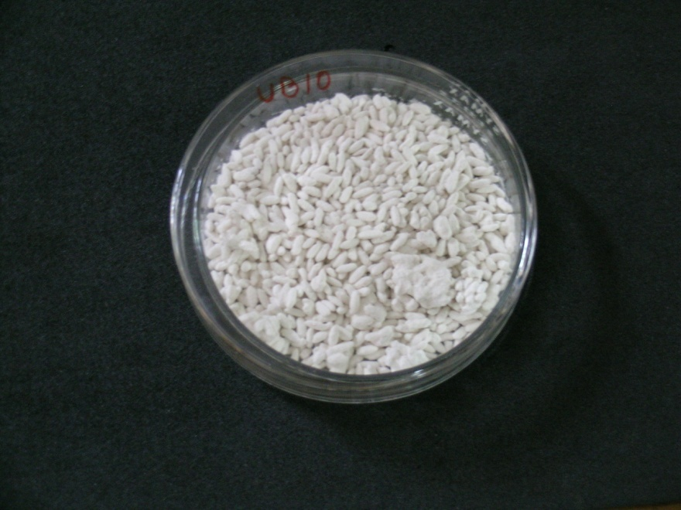
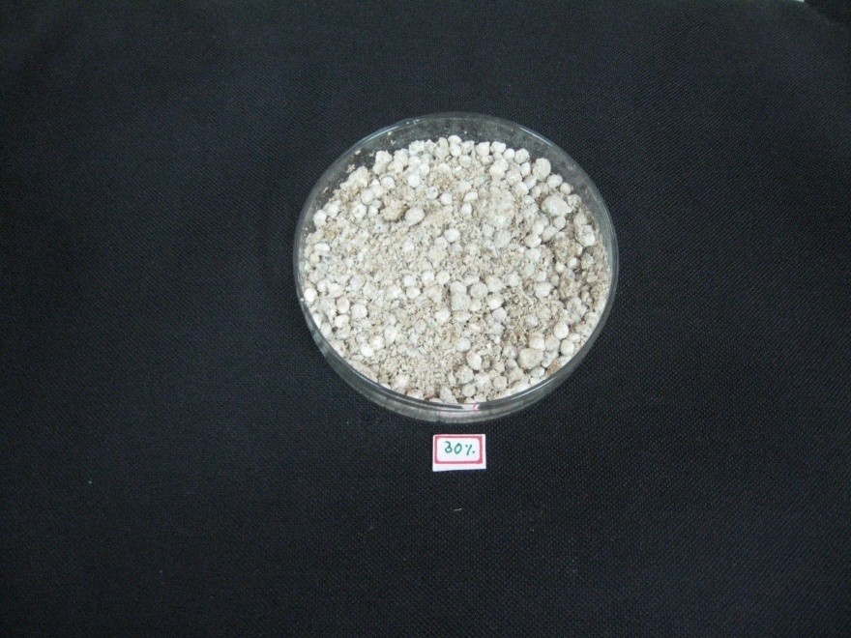
Mass production – B. bassiana
Rice – 40% Humidity
Spore output 5.6x10⁹
Sorghum+rice bran – 30% Humidity
Spore output 1.3x10⁹

Slide 14
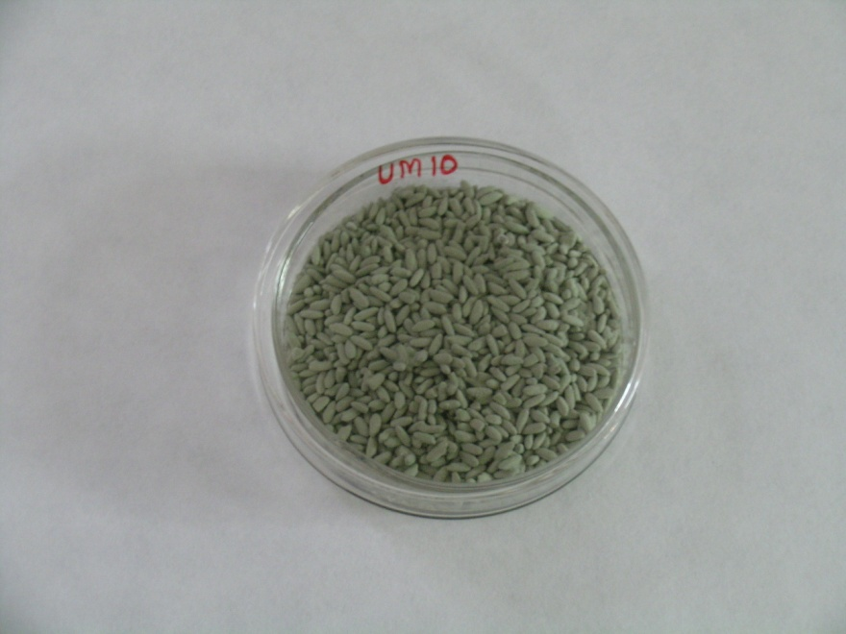
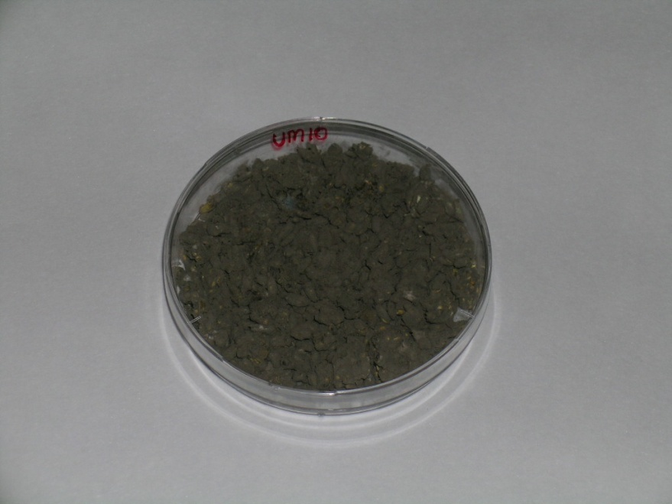
Mass production – M. anisopliae
Rice – 65% Humidity
Spore output 1.99x10¹⁰
Rice – 40% Humidity
Spore output - 1.1x10⁹

Slide 15
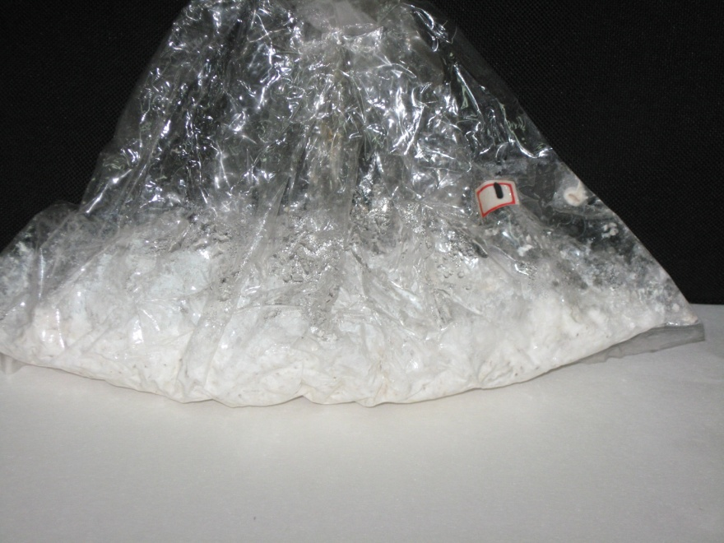
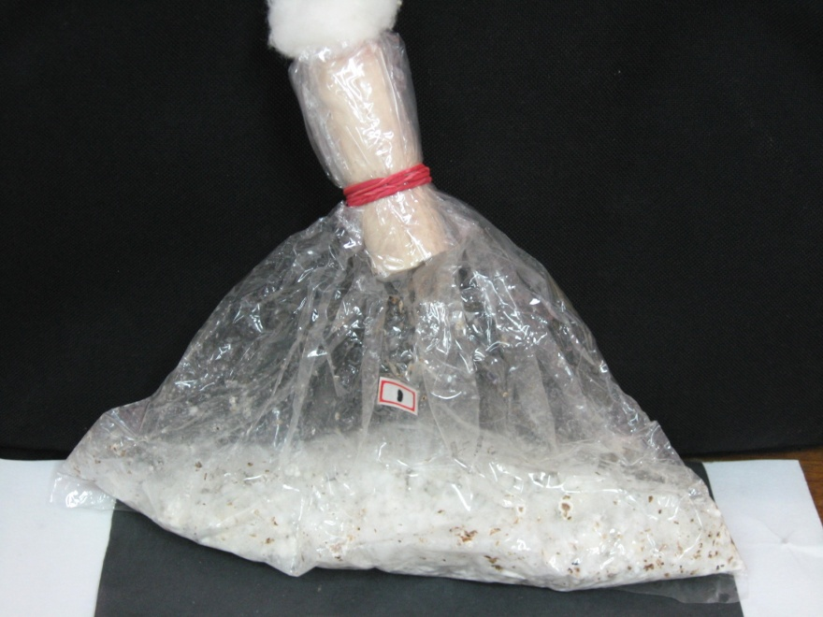
Mass production – B. bassiana
Rice with 1% yeast extract
Spore output 2.52x10⁹
Sorghum with 1% yeast extract
Spore output 3.6x10⁹

Slide 16
Formulation and Application of Mycoinsecticides
Compatibility between production, formulation and application techniques is vital for the successful use.
Formulation is important in terms of improved survival during storage, persistence in the field and ease of application.
Can be formulated as wettable power and oil formulations.
Powder formulations can be done in talc, silica gel, powdered rice and cornstarch. Algination is also reported.
Viability retains for just 1-8 months when stored at room temperature but can retain for 7 years when stored under low temperatures.
Ultra low volume (ULV) spraying, rotary atomizers, electrostatically-charged ULV sprayers, hydraulic spray systems etc have been used.
Spray supplements like surfactants, emulsifiers, dispersing agents, antievaporants etc may be necessary for efficient application

Slide 17
Formulation of the mass produced conidia
It is imperative to assess the shelf-life of the mass produced conidia and increase the shelf life during storage with proper formulations
Dry matrix:
Diatomaceous earth
Fullers earth
Kaolin
Oils:
Coconut oil
Mustard oil
Soybean oil
Oil and water emulsions:
Coconut oil and water emulsion
Mustard oil and water emulsion
Soybean oil and water emulsion
Sodium alginate encapsulation
Conidial viability checked by ability of conidia to germinate in the agar-microscope slide assay by at the end on each month up to six months

Slide 18
Methods to Increase the potency
Overexpression of endogenus genes which are over expressed during host -pathogen interaction process
Chitinases (BbChit1)
Proteases (Pr1)
Lipases
Endogenus
gene(s)
Reduction in LT₅₀ values : 20-25 %
Overexpression of Heterologous originated genes with insecticidal properties
LT₅₀ 36.7 % reduction against
Dendrolimus punctatus
Neurotoxic genes from
arachnids and scorpions
Heterologous
gene(s)

Slide 19
Bioactives from EPF
Several metabolites produced by entomopathogenic fungi have shown toxicity to a number of insect pests.
B. bassiana produces toxins like beauvericin, beauverolides, bassianolides and all cyclotetradepsipetides.
On the other hand, M. ansiopliae also produces toxic metabolites, the best described of these are the destruxins and Swainsonine.
Insect cell lines and human leukemic cell lines are being used in recent times to check the toxicity levels of these produced by EPF.

Slide 20
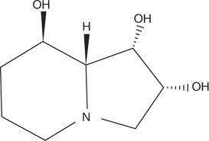
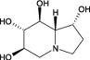
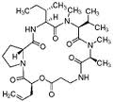
Mycotoxins from Metarhizium Species
Swainsonine inhibits the processing of asparagine-linked glycoproteins by impeding the action of Golgi α-mannosidase II as well as lysosomal mannosidase.
Metarhizium anisopliae
Destruxin
Swainsonine
Castanospermine
Insecticidal
Antiviral
phytotoxic
Mannosidase -II inhibitor
Glucosidase inhibitor

Slide 21
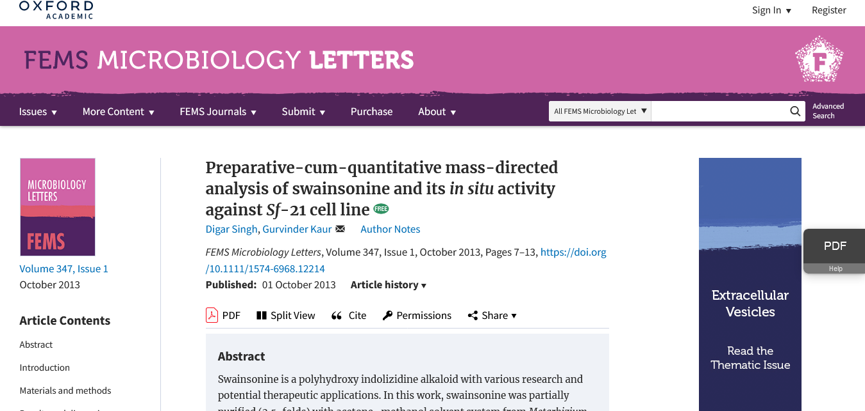
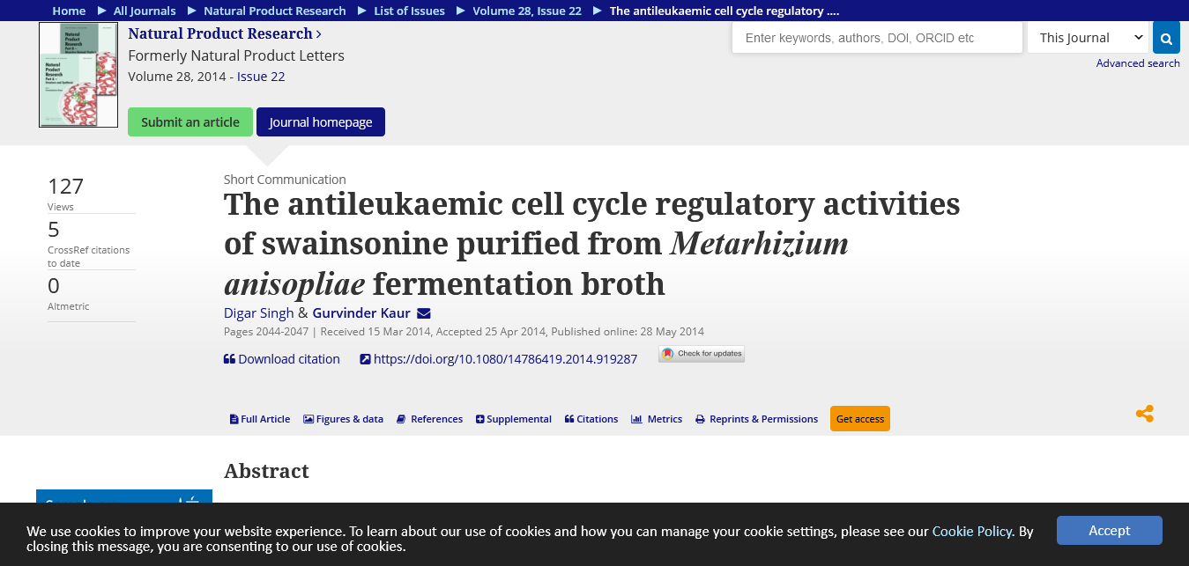

Slide 22
Exploitation of Endogenous gene(s)
“Genes which are over expressed during the infection process”
Metarhizium anisopliae
Gene | Source | Function | Outcome
Pr1 | M. anisopliae | Degrade insect cuticle | LT₅₀ - 25 % Manduca sexta
Beauveria bassiana
Gene | Source | Function | Outcome
CHIT1 | B. bassiana | Degrading insect cuticle | Increased virulence by 23 %
BbCDEP-1 + BbCHIT1 | B. bassiana | Degrading insect cuticle | Decreased spore dosage by 67 %

Slide 23
Exploitation of insecticidal toxins
Scorpion and spider neuropeptides
“The most important tool for scorpions and spiders to predate and exercise self-defense”
Toxins or Peptides comprised of proteins ranging from 30-80 amino acid residues mainly targeting ion channels
Peptides
Short Peptides
K⁺ channels
Long chains
Na⁺ channels
α -toxins
mammalian Na⁺ channels
β -toxins
Insect Na⁺ channels
Depressant toxins
Blocking neuronal action potentials
Excitatory toxins
Repetitive firing of neuron

Slide 24
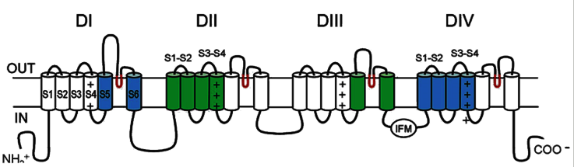
Scorpion toxins action on VGSCs
α -toxins
mammalian Na⁺ channels
β -toxins
Insect Na⁺ channels
Scorpion α-toxins bind to receptor site 3 (extracellular loops S1-S2 and S3-S4 at DIV and S5-S6 at DI) on sodium channels which blocks the channel activation
β-toxins bind to receptor site 4 (extracellular loops S1-S2 and S3-S4 at DII and S5-S6 at DIII) and trap inactivation channels which induce repetitive firing of action potentials
(Cestele and Catterall, 2000; Gurevitz, 2012)

Slide 25
Metarhizium engineered to control crop pest
AaIT1
Well characterized β-insect excitatory toxin which binds to receptor site 4 on VGSCs.
It has been proven that is not toxic to mammals even at 100 fold more concentration.
Gene | Source | Function | Outcome
AaIT1 | Androctonus australis | Modifies the gating mechanism of sodium channel | 22-fold increase in virulence
AaIT1+ Pr1 | A. australis and B. bassiana | Dual activity with cuticle degrading and sodium channel blocker function | Reduced LT₅₀ -40 %
BjαIT | Buthotus judaicus | Sodium channel modifier | Increased virulence

Slide 26
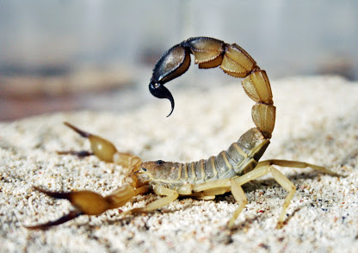
β-BUTX Lqq1a-Scorpion neurotoxin
Leuirus quinquestriatus quinquestriatus, β-BUTX Lqq1a toxin
70 amino acids including 8 half cysteine residues at the positions 16-37, 22-42, 26-44, 38-64
Flaccid paralysis in insects which is caused by repetitive firing (Kopeyan et al., 1990)
β toxins- bind to the receptor site 4 (Domain II and III) (Gurevitz, 2012)
Closely resembles insect specific β toxin Aa IT1 from A. australis
Non toxic to mammals (Ji et al., 2002)

Slide 27
Engineering entomopathogenic fungi
Use of Scorpion toxin Gene in fungi to enhance the pathogenicity by rDNA technology.
Scorpion toxin are selectively active on lepidopterous and dipterous insects.
Cause an immediate contraction paralysis in blowfly larvae.
Composed of 70 -76 aa
Less than 30% identity with mammals
Scorpion insect toxin
Excitatory (LqqIT1)
Depressant (LqqIT2)
α insect toxin
(LqHαIT)
A transient contraction paralysis followed by slow flaccid paralysis.
Composed of 59-61 aa
50% identity with mammals
Delayed and sustained contraction paralysis potent to mammals also.
Composed of 64-66 aa
> 70% identity with mammalian α toxin.

Slide 28
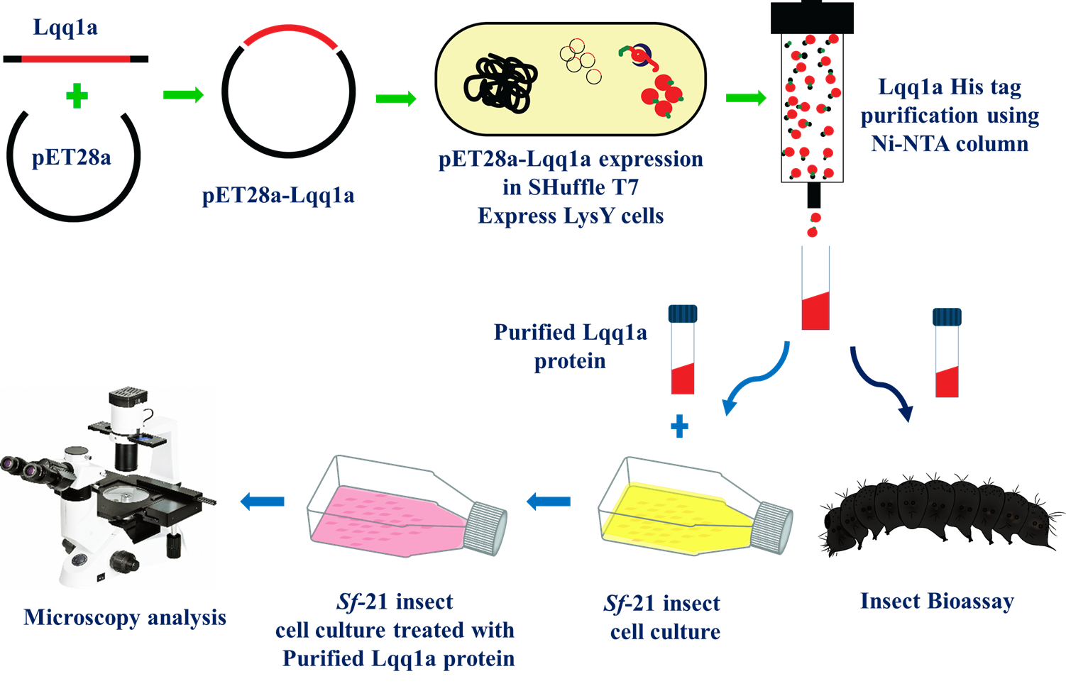
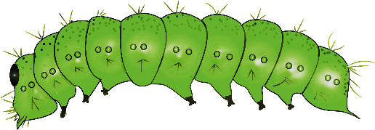
Schematic representation of bacterial expression, purification and cell culture studies of recombinant Lqq1a

Slide 29
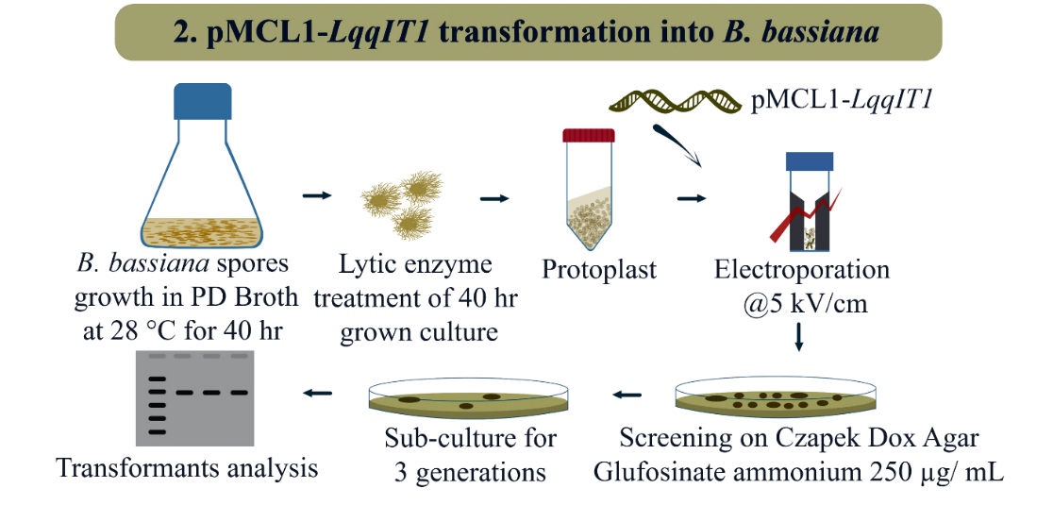
Based on the native protein sequence, corresponding gene sequence has been codon optimized for the expression in Beauveria, Metarhizium. In addition to the toxic gene sequence 5’ Untranslated region (UTR, Kozak sequences) and Mcl1 signal peptide has been included at the 5’ region from Metarhizium collagen like protein, to transport the protein of interest to hemolymph. The sequence was codon optimized using Metarhizium anisopliae and Beauveria bassiana codon usage
Schematic representation of PMcl1-Lqq IT1 cloning in B. bassiana using protoplast transformation.

Slide 30
LqqIT1 protein expression and purification studies in E. coli and testing the efficacy of purified protein on insects (or) insect cell lines (Sf-9 and Sf-21) and Human cell line.
2a. Cloning, expression of the LqqIT1 in Metarhizium and Beauveria and insect toxicity studies
3a. Genes stacking using Lectin and B. thuringiensis Cry protein with LqqIT1 and insect toxicity assays

Slide 31
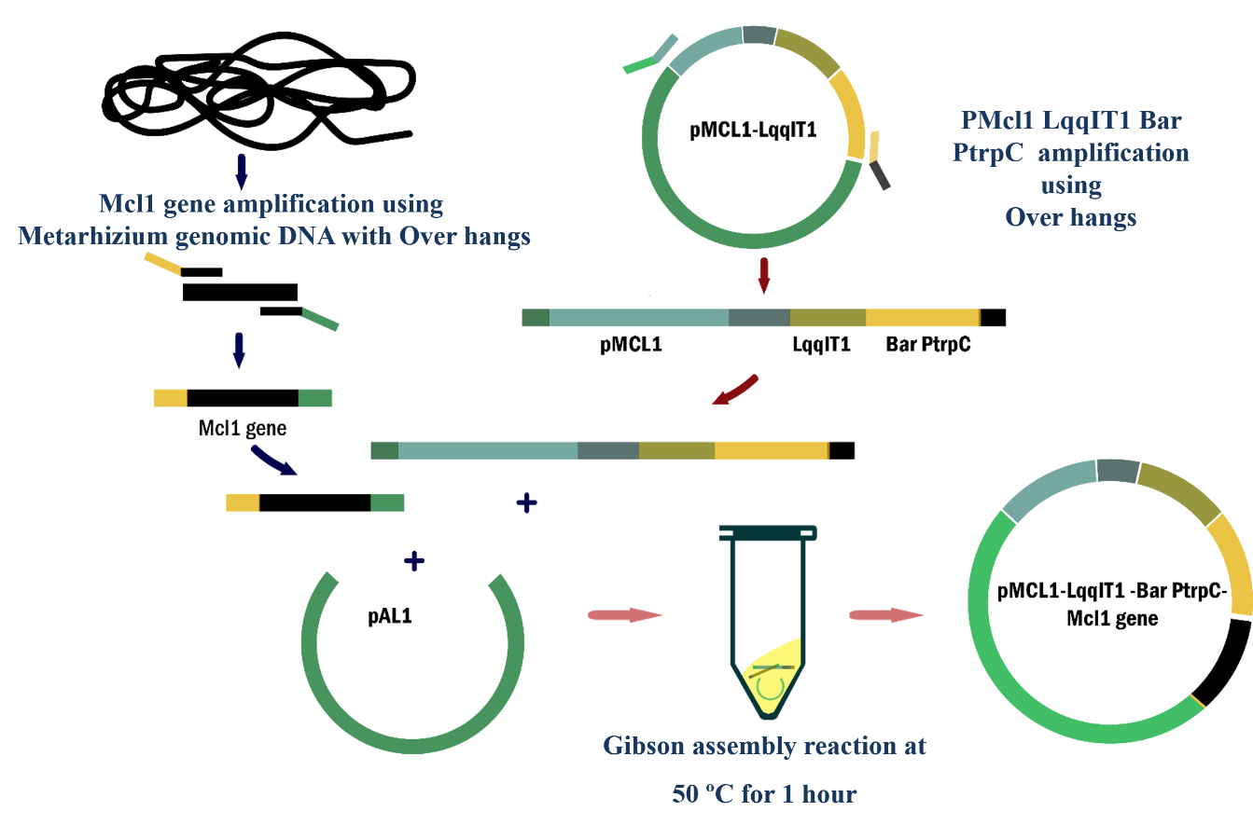
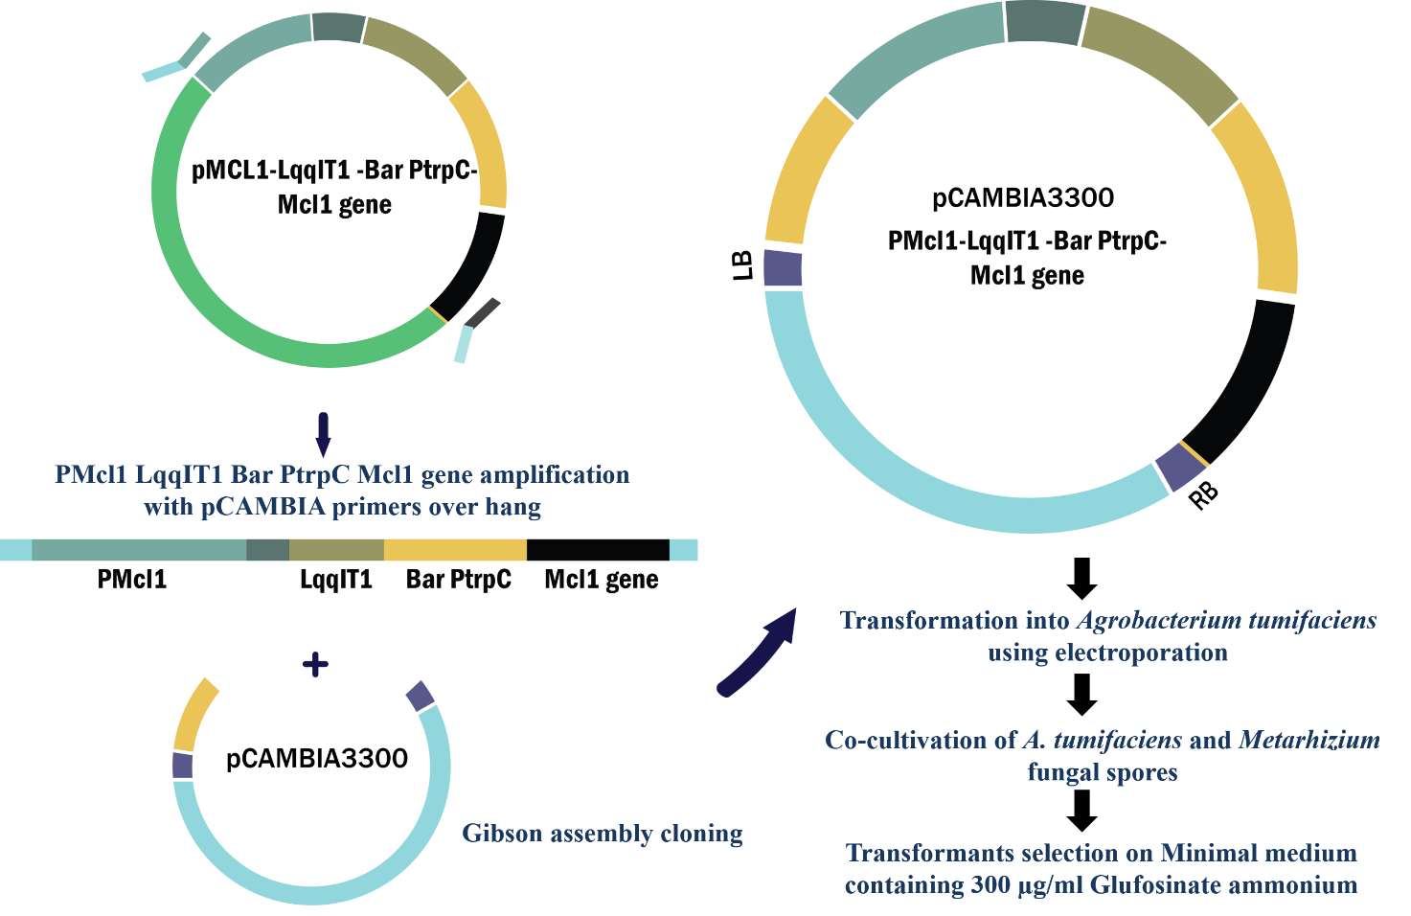
Schematic representation of LqqIT1 cloning into Metarhizium anisopliae pMcl1 Lqq IT1 Bar PTrpC Mcl1 gene overlap vector construction.
Schematic representation of LqqIT1 cloning into Metarhizium anisopliae pCAMBIA 3300 PMcl1LqqIT1 overlap vector construction.

Slide 32
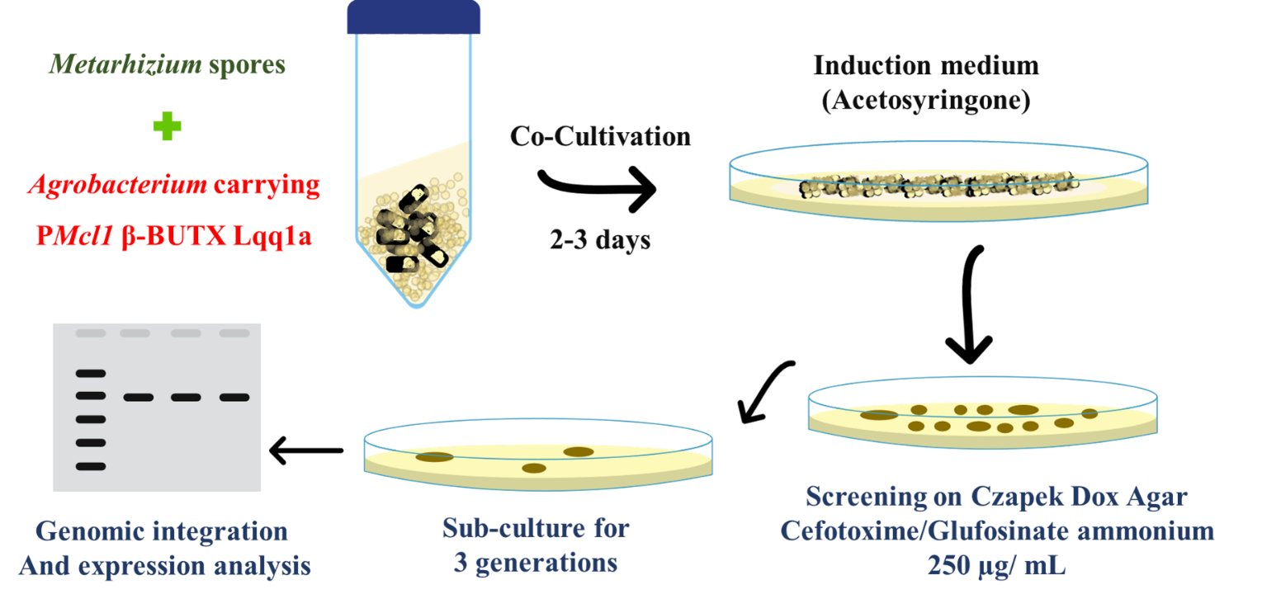
Schematic representation of Agrobacterium mediated transformation of M. anisopliae

Slide 33
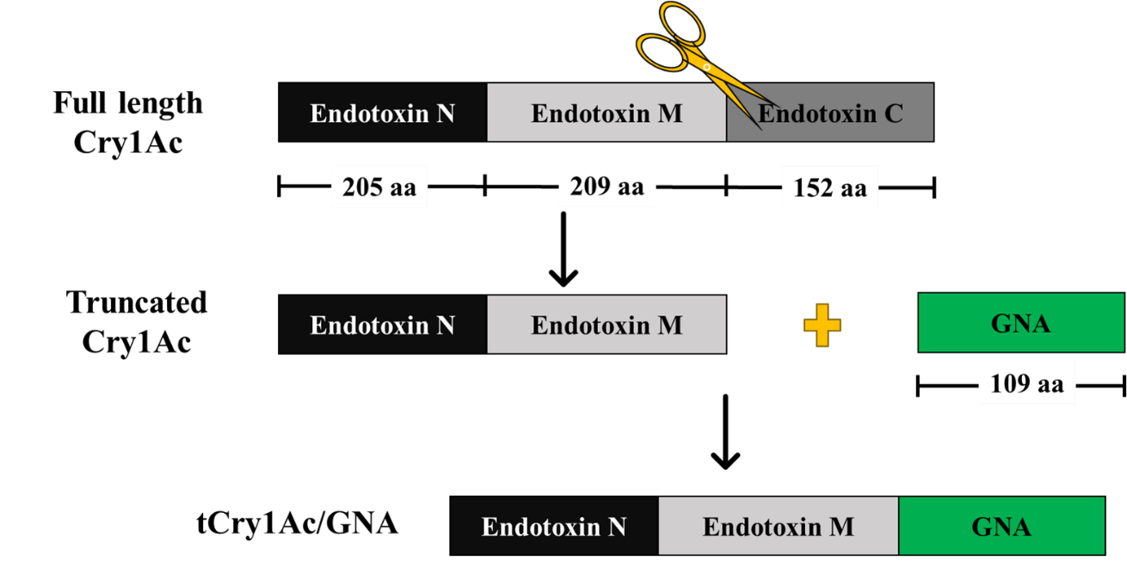
Genes stacking using Lectin and B. thuringiensis Cry protein with LqqIT1 and insect toxicity assays
Plant lectins are heterogeneous group of defense protein molecule that recognize and bind reversibly to the carbohydrate moieties
Schematic representation of strategies followed for the fusion of Cry1Ac and GNA lectin

Slide 34
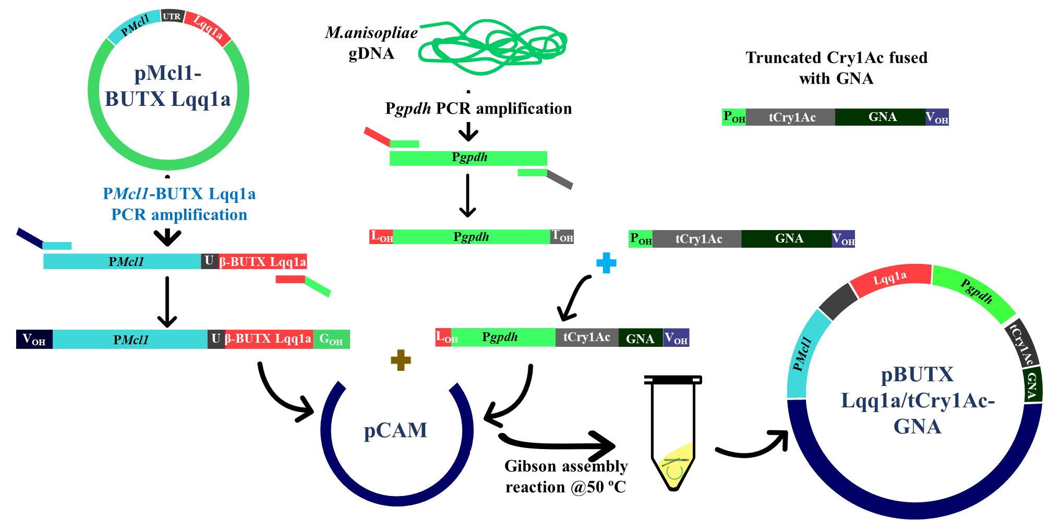
Flow chart for the cloning of β-BUTX-Lqq1a and Cry1Ac/GNA in Agrobacterium plasmid (pCAMBIA3300)

Slide 35


Slide 36
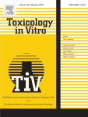
Toxicology in Vitro
Volume 94, February 2024, 105737
In vitro anticancer effects of recombinant anisoplin through activation of SAPK/JNK and downregulation of NFκB
Author links open overlay panel, , ,
https://doi.org/10.1016/j.tiv.2023.105737Get rights and content

Slide 37
Future of Entomopathogenic fungi
Good mass production – formulation – application (to reach the field for use by farmers).
Strain improvement – via genetic engineering
(over expressing extracellular enzymes to increase the rate of virulence).
Engineering fungi with other neuro toxic genes from Scorpion, snake venom, wasps, etc.
Continued investment in research, technology transfer and education

